Slide 1

LMS

Slide 2
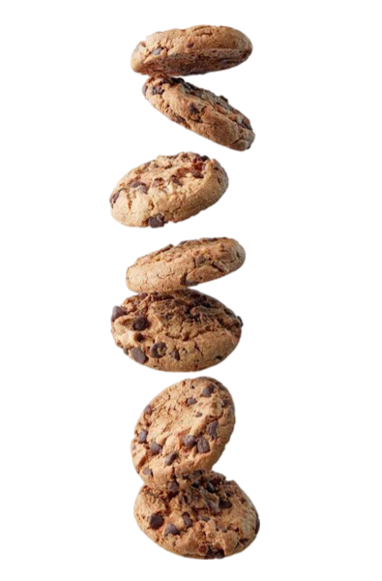

.
You Ship We Ship

Slide 3

What are you doing here?
You will
Learn the basics of CAD by designing and creating your own cookie cutter
Get your cookie cutter printed out
Get cookies!!!!

Slide 4

So, let’s get started!
First, sign up or log into TinkerCAD
Once you’re signed in, create a document and name it “Cookie Cutter” or something else relevant

Slide 5
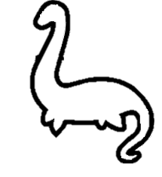
Choose your design!
Decide what you want to do
Talk to your friends and brainstorm ideas
Sketch an outline of it using either digital tools or paper
Find something that has a simple outline, like this loch ness monster!
You can draw it in Microsoft Paint, Canva, Figma or something else
Once you’ve got your outline, save an image of it to your computer, then convert it to an SVG. You can do that through this website:
https://picsvg.com

Slide 6
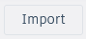
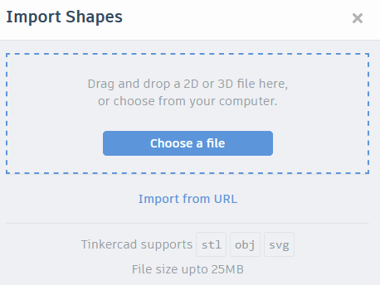

Import the image into TinkerCAD
Now that you have your template, we can start designing!
Click the import button in the top right
Select your chosen file and click “open”
A loading bar will appear in the bottom left and tell you once your image has been successfully imported

Slide 7
Size
Click on your image and then HOLD SHIFT and click one of the white boxes on the outline of the shape.
In general, your outline probably shouldn’t be over 100mm x 100mm (the dimensions that you type in are in mm)

Slide 8

3D Time
Duplicate the shape, and make it 2mm smaller on each side (don’t hold shift when changing the new shape’s proportions)
Then with the smaller shape selected, click hole
Then hold control and select both shapes then click group

Slide 9

Pretty little border
Duplicate the shape
Change the dimensions of the new shape
Thickness ~ 5mm
Depth ~ 2mm
Make sure they are positioned on top of one another!
Now select both parts and click group

Slide 10
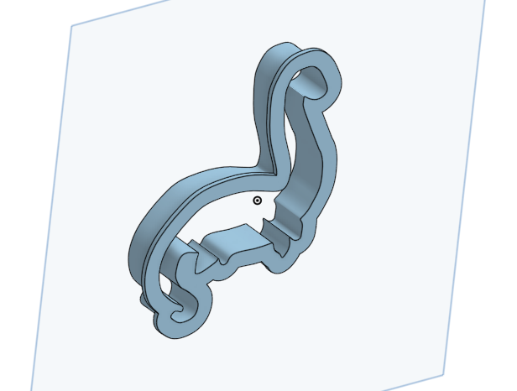
ADMIRE IT!
Look at your finished design!
Isn’t it pretty?
Feel happy and proud
…until you realize that there are still more slides to go through

Slide 11
Screenshot
Take a screenshot of your design (like so) and save it to your computer
You will need this for submission

Slide 12
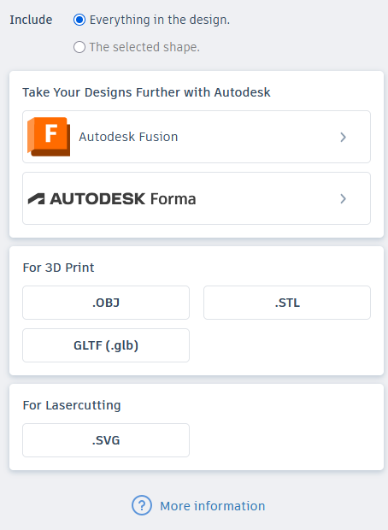
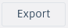
Export
Now it’s time to export it!
Click the button in the top right
Select
Then select

Slide 13
Export
You should now have a .STL file of your cookie cutter saved to your computer
Now visit https://tinyurl.com/STLtoSTEP
Convert your file to .STEP for submission

Slide 14

Submitting
Go to the BakeBuild submit form (https://tinyurl.com/bakebuildsubmit)
Select workshop and find ours
Fill out the form

